Slide 1


Oral Communication Skills A
(CELEN069)
Lesson 8.1

Slide 2
Lesson aims and objectives
By the end of this lesson, you should have enhanced your speaking and listening ability through practice.
In addition, you should be better able to … | Intended Learning Outcomes
identify stress, pausing and chunking, and intonation when listening | 1.1-1.3 1.6 2.2 2.3
use stress, pausing and chunking, and intonation appropriately when speaking

Slide 3

Stress
(Review)

Slide 4

Stress: Review
For homework, you were asked to review the Pronunciation Quiz. Let’s start by reviewing the basics.
How many syllables does each of the words below have?
Which syllable is stressed?
Word
Number of syllables
Stressed syllable
contrast
decrease
perfect
present
produce
con - trast
de - crease
per - fect
pre - sent
pro - duce
con – trast (n.) / con – trast (v.)
de – crease (n.) / de – crease (v.)
per – fect (adj.) / per – fect (v.)
pre – sent (n.) / pre – sent (v.)
pro – duce (n.) / pro – duce (v.)

Slide 5
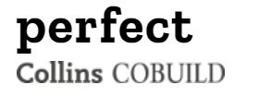
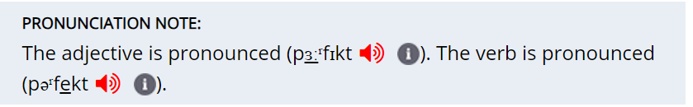
Stress: Review
Some words can have a different meaning if the word stress changes.
Hint:
You can check the pronunciation in a dictionary.
Look at the sentences below. Where should the word stress be for the underlined words in bold?
There’s a big contrast between life in high-school and life at university.
It can be a healthy habit to decrease the number of hours spent on your phone.
Trying to perfect every piece of work may be a cause of stress.
At present, 60 to 90 % of world languages are endangered.
Autonomous learners generally produce higher quality assignments.

Slide 6
Stress
(Sentence stress)

Slide 7
Stress: Sentence stress
Read each sentence aloud. The underlined word is stressed.
What is the difference in meaning between each sentence?
I saw John yesterday.
I saw John yesterday.
I saw John yesterday.
I saw John yesterday.
It was me who saw him, not someone else.
I saw him (not phoned or wrote to him etc).
I saw John (not Patrick, or Jerry, or Tim etc).
It was yesterday that I saw him (not at the weekend, or last week).

Slide 8
Stress: Sentence stress
Unlike word stress, where a dictionary can help you identify which syllable you should stress, sentence stress is chosen by the speaker depending on the meaning they intend to convey.
e.g. I love you. (Bob doesn’t love you.)
I love you. (I don’t hate you.)
I love you. (I don’t love Bob.)

Slide 9
Stress: Sentence stress
Now, read these sentences, so that they convey the meaning shown in brackets. Make sure you stress the correct word.
From my point of view, university life is exciting. (I disagree with you.)
From my point of view, university life is exciting.
What do you think about this topic? (I am asking you, not the other person.)
What do you think about this topic?
I don’t think this is the most important skill. (Another aspect is more important.)
I don’t think this is the most important skill.
I agree to some extent. (not entirely)
I agree to some extent.
OK, so what’s the third most important skill? (not the first or second)
OK, so what’s the third most important skill?

Slide 10
Stress: Sentence stress
Decide which word you need to stress in each of the sentences to express the different meanings below each one.
Work in pairs. Read each sentence out to your partner. Your partner should guess the meaning that you’re trying to convey.
(c)
(a)
1. We’ve been asked to discuss the topic of soft skills in the workplace.
not hard skills
not at university
not write about it
2. According to the lecture, some students struggle with time management.
no issues with managing other aspects of their life
not all students
this is not my personal opinion
3. One example of this is using Outlook calendar to help you remember deadlines.
not other calendars
not forget
there are many examples
4. So we all agree that time management is the most challenging skill to improve?
not disagree
ranked first
not easy
(c)
(b)
(a)
(a)
(c)
(a)
(b)
(b)
(c)
(b)

Slide 11
Pausing and chunking

Slide 12

Pausing and chunking
Listen to the sentence below spoken in two different ways. Which one sounds more ‘natural’?
Justify your choice.
Do your best on the project, and don’t worry if it’s not perfect. Just finish it on time.

Slide 13
Pausing and chunking
Which one sounds more ‘natural’? Justify your choice.
Do your best on the project, and don’t worry if it’s not perfect. Just finish it on time.
A
Very little pausing.
Do your best on the project, / and don’t worry / if it’s not perfect. / Just finish it / on / time.
B
Pausing helps the listener to understand where a phrase, a sentence or a paragraph ends and the next begins. Pausing can also be used along with stress for emphasis.

Slide 14
Pausing and chunking
Listen to the two recordings. Which version sounds more ‘natural’? Justify your choice.
Well, as far as I’m concerned, I think that university time is a period when you can learn more about yourself and develop as an individual.
Listen again to the more ‘natural’ one and mark the pausing on the script.

Slide 15
Pausing and chunking
Which version sounds more ‘natural’? Justify your choice.
A
Well, as / far as I’m / concerned, I think / that university / time is a / period when you / can / learn more / about / yourself and develop / as an individual.
B
Well, / as far as I’m concerned, / I think that / university time / is a period / when you can learn more about yourself/ and develop as an individual.
It is more natural to use pausing at the end of a chunk of language. A chunk refers to a word or group of words that generally work together.

Slide 16
Pausing and chunking
Work in groups of three.
Read the discussion below and decide where it would be logical to pause. Role-play the discussion with your group.
Practise role-playing the discussion to another group of students. Did both groups use pausing in the same places? Compare your choices.
A: What do you think are some suitable ways to improve your language skills?
B: Well, from my own personal experience, I can say that finding a language exchange partner can help greatly.
C: Could you tell us a bit more about that?
B: Sure. For example, I meet my language exchange partner every week. Before we meet, we decide what topic we want to focus on and we research it.
A: You mean you find vocabulary related to that?
B: No, we usually read the news or find journal articles and then we discuss them.
C: I guess by reading those you’d be learning new vocabulary too.
B: Yes.
A: That sounds better than just memorising a vocabulary list on a topic.
B: Yes. I’ve actually found an article that suggested that if you read about a topic you’re interested in, it’s easier to remember relevant vocabulary.
C: Wow. That sounds like a great way.

Slide 17
Intonation

Slide 18
Intonation
Read out the statement in the speech bubble. Change the stress, pausing and intonation to reflect each of the situations on the right.
It’s 9 o’clock!
Hurry up! You’re late for class!
We’ve got plenty of time. Class doesn’t start till 11:00.
It’s not 10 o’clock.
Be quiet.
Yippeee!
I’ve overslept!
It’s too early to eat again. I’ve only just had breakfast.
Time to start the class.

Slide 19
Intonation
Listen to the recording and match each version of the statement to its situation. Is the recorded version similar to how you pronounced it in the previous task?
Hurry up! You’re late for class!
We’ve got plenty of time. Class doesn’t start till 11:00.
It’s not 10 o’clock.
Be quiet.
Yippeee!
I’ve overslept!
It’s too early to eat again. I’ve only just had breakfast.
Time to start the class.
4
2
It’s 9 o’clock!
7
Intonation can change depending on the speaker so some of your answers may vary.
3
6
8
1
5

Slide 20
Intonation
When a person speaks, they use intonation. There are different types of intonation, but today we will focus on rising and falling.
Rising intonation ↗↘can be at the end of a chunk:
when you’re in the middle of a sentence.
when you’re asking a question or to show uncertainty.
Falling intonation can be at the end of a chunk:
when you are at the end of a sentence.
I like chocolate, and I eat it every day.
I like chocolate. Do you?
↗
↘
↘
↗

Slide 21
Intonation
Listen to the recording. For each utterance tick the column that reflects the speaker’s meaning.
Utterance | showing uncertainty | making a statement | unfinished utterance
1
2
3
4
5
6

Slide 22
Intonation
Some students may not be confident enough to speak with each other in English.
showing uncertainty
unfinished utterance
making a statement
unfinished utterance
making a statement
showing uncertainty
Having good communication skills can help you get a better job in the future.
Work in pairs.
Read the utterances using different types of intonation to express different meanings. Your partner should guess the meaning that you’re trying to convey.

Slide 23
Practice (1)

Slide 24
Practice (1)
Listen to an extract from the group discussion sample from Lesson 6.2. As you listen, mark the sentence stress, pausing and chunking (/), and intonation (↗)(↘) .
Robert: And then, yeah, the third one then would be, what was it then? … the promotion of local cultures, isn’t that right?
John: Yes, through English.
Robert: … through English.
John: And I do think that … that is big as social media expands and you can read about most cultures on the internet.
Michaela: And it’s quite positive as well.
John: Yes, it’s quite positive.
Robert: Yeah.
Michaela: But I do agree that that should come last because social media and the Internet are kind of a newer thing, so I think that the impact of … promoting the local culture through the medium of English is kind of a recent thing as well. So in that case the impact hasn’t been that great yet.
Note: ‘…’ shows hesitation rather than pausing.

Slide 25
Practice (1)
Suggested answers:
Robert: And then, yeah, the third one then would be, what was it then? … the promotion of local cultures, isn’t that right?
John: Yes, through English.
Robert: … through English.
John: And I do think that … that is big as social media expands and you can read about most cultures on the internet.
Michaela: And it’s quite positive as well.
John: Yes, it’s quite positive.
Robert: Yeah.
Michaela: But I do agree that that should come last because social media and the Internet are kind of a newer thing, so I think that the impact of … promoting the local culture through the medium of English is kind of a recent thing as well. So in that case the impact hasn’t been that great yet.

Slide 26
Practice (1)
Suggested answers:
Robert: And then, / yeah, the third one then would be, / what was it then? / … the promotion of local … cultures, isn’t that right?
John: Yes, through / English.
Robert: … through English.
John: And I do think that … that is / big / as / social media expands and you can read about / most cultures on the internet.
Michaela: And it’s quite positive as well.
John: Yes, it’s quite positive.
Robert: Yeah.
Michaela: But / I do agree that … that should come / last / because / social media and the Internet / are kind of a newer thing, / so I think the impact of … promoting the local culture through the medium of English / is kind of a recent thing as well. So in that case / the impact / hasn’t been that great / yet.

Slide 27
Practice (1)
Suggested answers:
↗
↘
↗
↗
↗
↘
Robert: And then, yeah, the third one then would be, what was it then? … the promotion of local cultures, isn’t that right?
John: Yes, through English.
Robert: … through English.
John: And I do think that … that is big as social media expands and you can read about most cultures on the internet.
Michaela: And it’s quite positive as well.
John: Yes, it’s quite positive.
Robert: Yeah.
Michaela: But I do agree that that should come last because social media and the Internet are kind of a newer thing, so I think that the impact of … promoting the local culture through the medium of English is kind of a recent thing as well. So in that case the impact hasn’t been that great yet.
↗
↘
↘
↗
↗
↘
↗
↗
↗
↘
↗
↘
↗
↗
↗
↗
↗
↘
↗
↗
↗
↗
↗
↗
↗
↘

Slide 28
Practice (2)

Slide 29
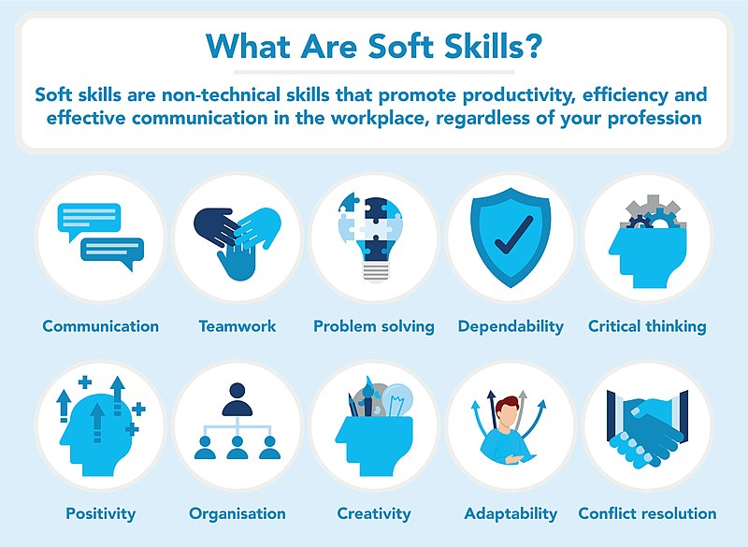
Practice (2)
Work in groups of 3-4. Write down a script for a discussion based on the prompt.
Practise reading out the discussion focusing on using appropriate sentence stress, pausing and chunking, and intonation.
When you’re ready, act out the discussion to another group of students.
What is the most important soft skill for the workplace?

Slide 30

Reminder: Live Lecture 2
Your next OCSa lesson will take place on Friday 22nd November. It will be a live lecture, so do not come to this classroom. Instead, go to DH Lawrence Auditorium. Please note that the Live Lecture 2 notes are assessed (Listening Portfolio - Task 2). Submit a copy of your notes via the submission box on the OCSa Moodle page by Monday 25th November, 3pm.
Homework
Due | Task
Lesson 8.2 | Read the Soft skills in the workplace (from OCSa Moodle, Week 8 section) before attending Live Lecture 2.
Lesson 9.1 | Complete ‘Social media use survey’ (Class Workbook - Lesson 9.1). Complete ‘Vocabulary building’ tasks A & B (Class Workbook - Lesson 9.1 ).

Slide 31

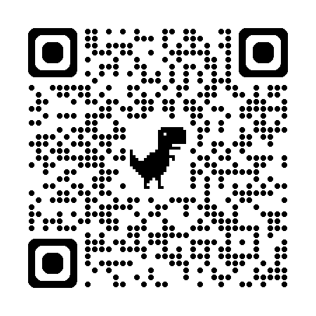
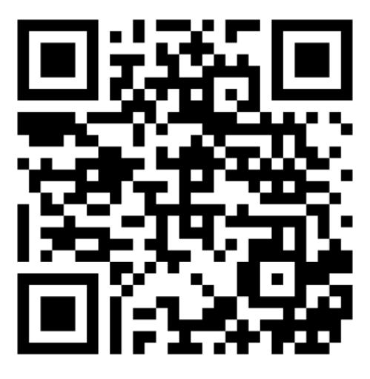
Week 8
Extra resources for OCSa this week on the Writing Lab Moodle page:
Speaking → Pronunciation
Speaking → University speaking tasks (group discussions)
Next week (Week 9 – beginning the 25th of November):
Utalk continues!
Lunch time 1:00 – 1:50.
Monday, Tuesday, Wednesday, Thursday, Friday: PB 115
Evening sessions available – check the SPDPO credit system.
Sign-up using the SPDPO credit system.
Centre for English Language Education CELE N048 AY 24-25

